Slide 1
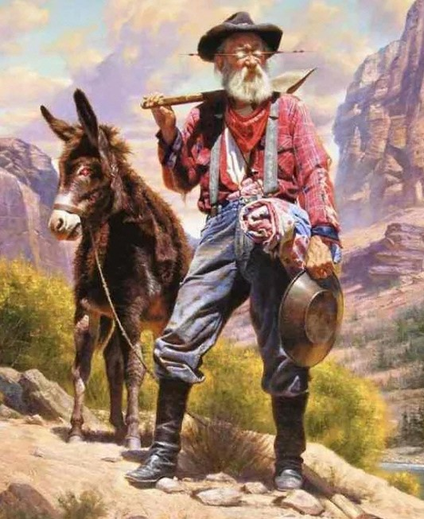
“There’s ‘Gold’ in them thar Roads!”
Steven S. Brosemer, Professional Surveyor

Slide 2
WHO AM I?
SON OF MY PRINCIPLE MENTOR, THE LATE JAMES H. BROSEMER, KS LS #0082.
GRADUATE OF WICHITA STATE UNIVERSITY IN SECONDARY EDUCATION AND AMERICAN HISTORY. FORMER SECONDARY EDUCATION TEACHER.
LICENSED BY EXAM IN 1980.
LICENSED IN PRIVATE PRACTICE FOR 44 YEARS.
REGULAR CONTRIBUTER TO SECTION LINES & PRESENTER OF SEMINARS.
PAST PRESIDENT OF KSLS (1988 & 1989) AND PAST BOARD MEMBER.
LIFETIME MEMBER OF KSLS.
HEAD CHAINMAN AWARD IN KANSAS (2) AND NEBRASKA.
THREE KSLS PRESIDENTIAL CITATIONS.
MEMBER OF THE BOARD OF DIRECTORS OF THE KSLS CHARITABLE FOUNDATION.
FORMER LAND SURVEY MEMBER OF THE KANSAS STATE BOARD OF TECHNICAL PROFESSIONS (KSBTP) FOR 3 TERMS FROM 2008-2018. Chair 2015-2016
CURRENT COMPLAINT INVESTIGATOR FOR THE KSBTP.
CONSULTANT TO THE KSBTP ON STATE SPECIFIC EXAM AND MINIMUM STANDARDS.
2012 CHAIR OF THE EMPORIA AREA CHAMBER OF COMMERCE.
ADJUNCT INSTRUCTOR AT KCKCC IN REAL PROPERTY LAW & BOUNDARY CONTROL
CO-AUTHOR OF BOUNDARY SURVEYING IN KANSAS - A GUIDE FOR SURVEYORS
“Kansas has 105 Counties. That means there are 105 Kingdoms.”
James H. (Tony) Brosemer, PS 82,
Who work for KDOT in all 105 counties.

Slide 3
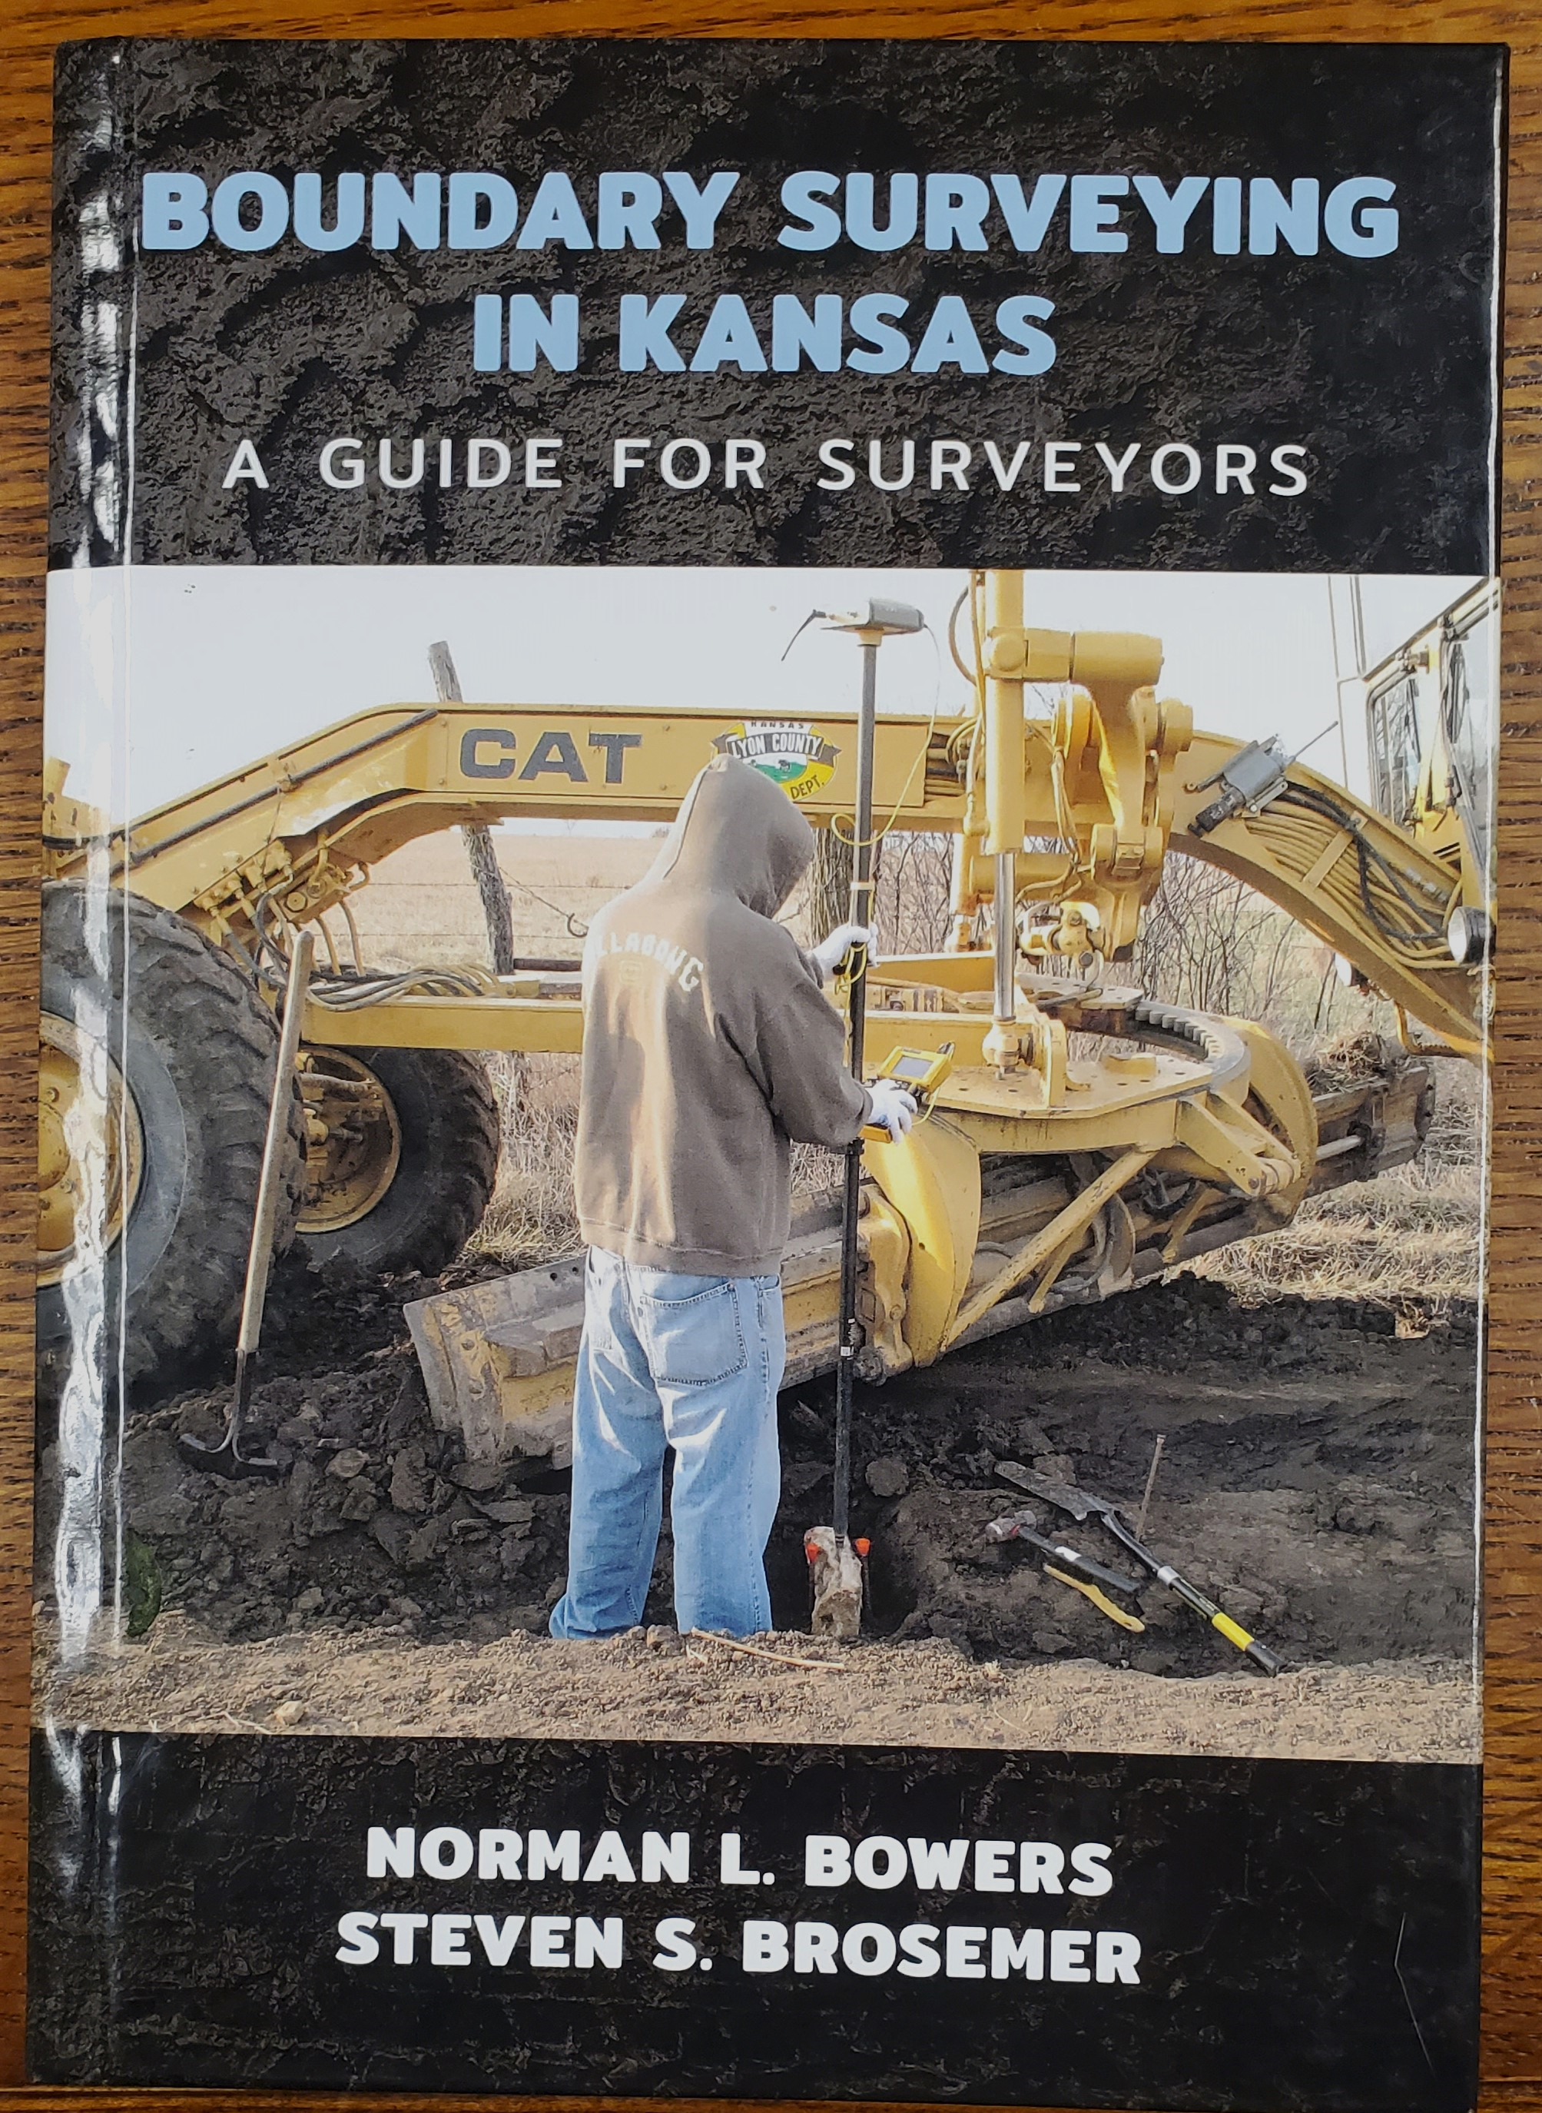
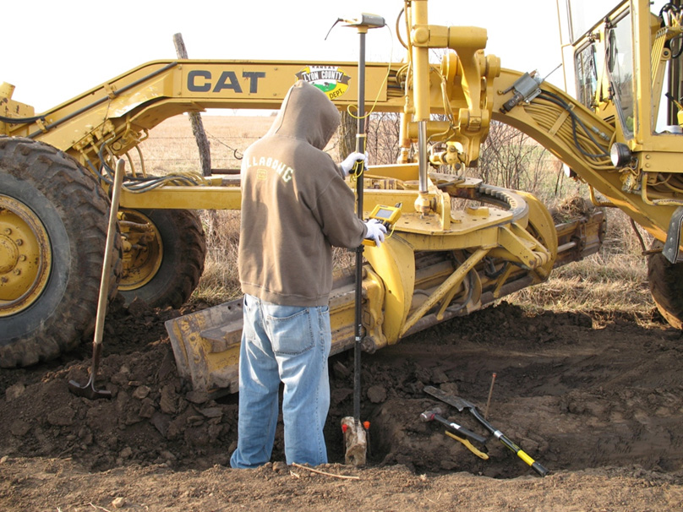
FINDING SURVEYOR & LANDOWNER GOLD!
THE ULTIMATE BENEFIT IS TO THE ULTIMATE END USER:
YOUR CITIZENS AND TAXPAYERS!

Slide 4
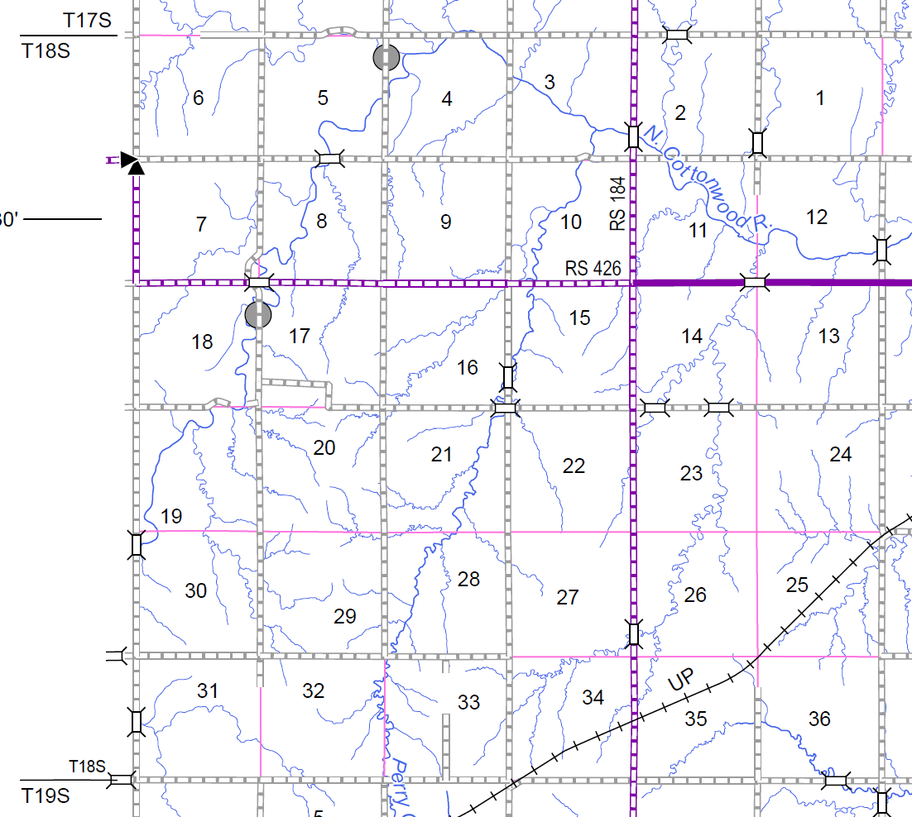
How are County Roads opened?
By Act of the Legislature
By KSA 68-102 et. seq.
By purchase (Road Deed)
By Donation
By Condemnation
They are ALL Legally Easements and they are generally on or near the PLSS lines of a Section.

Slide 5
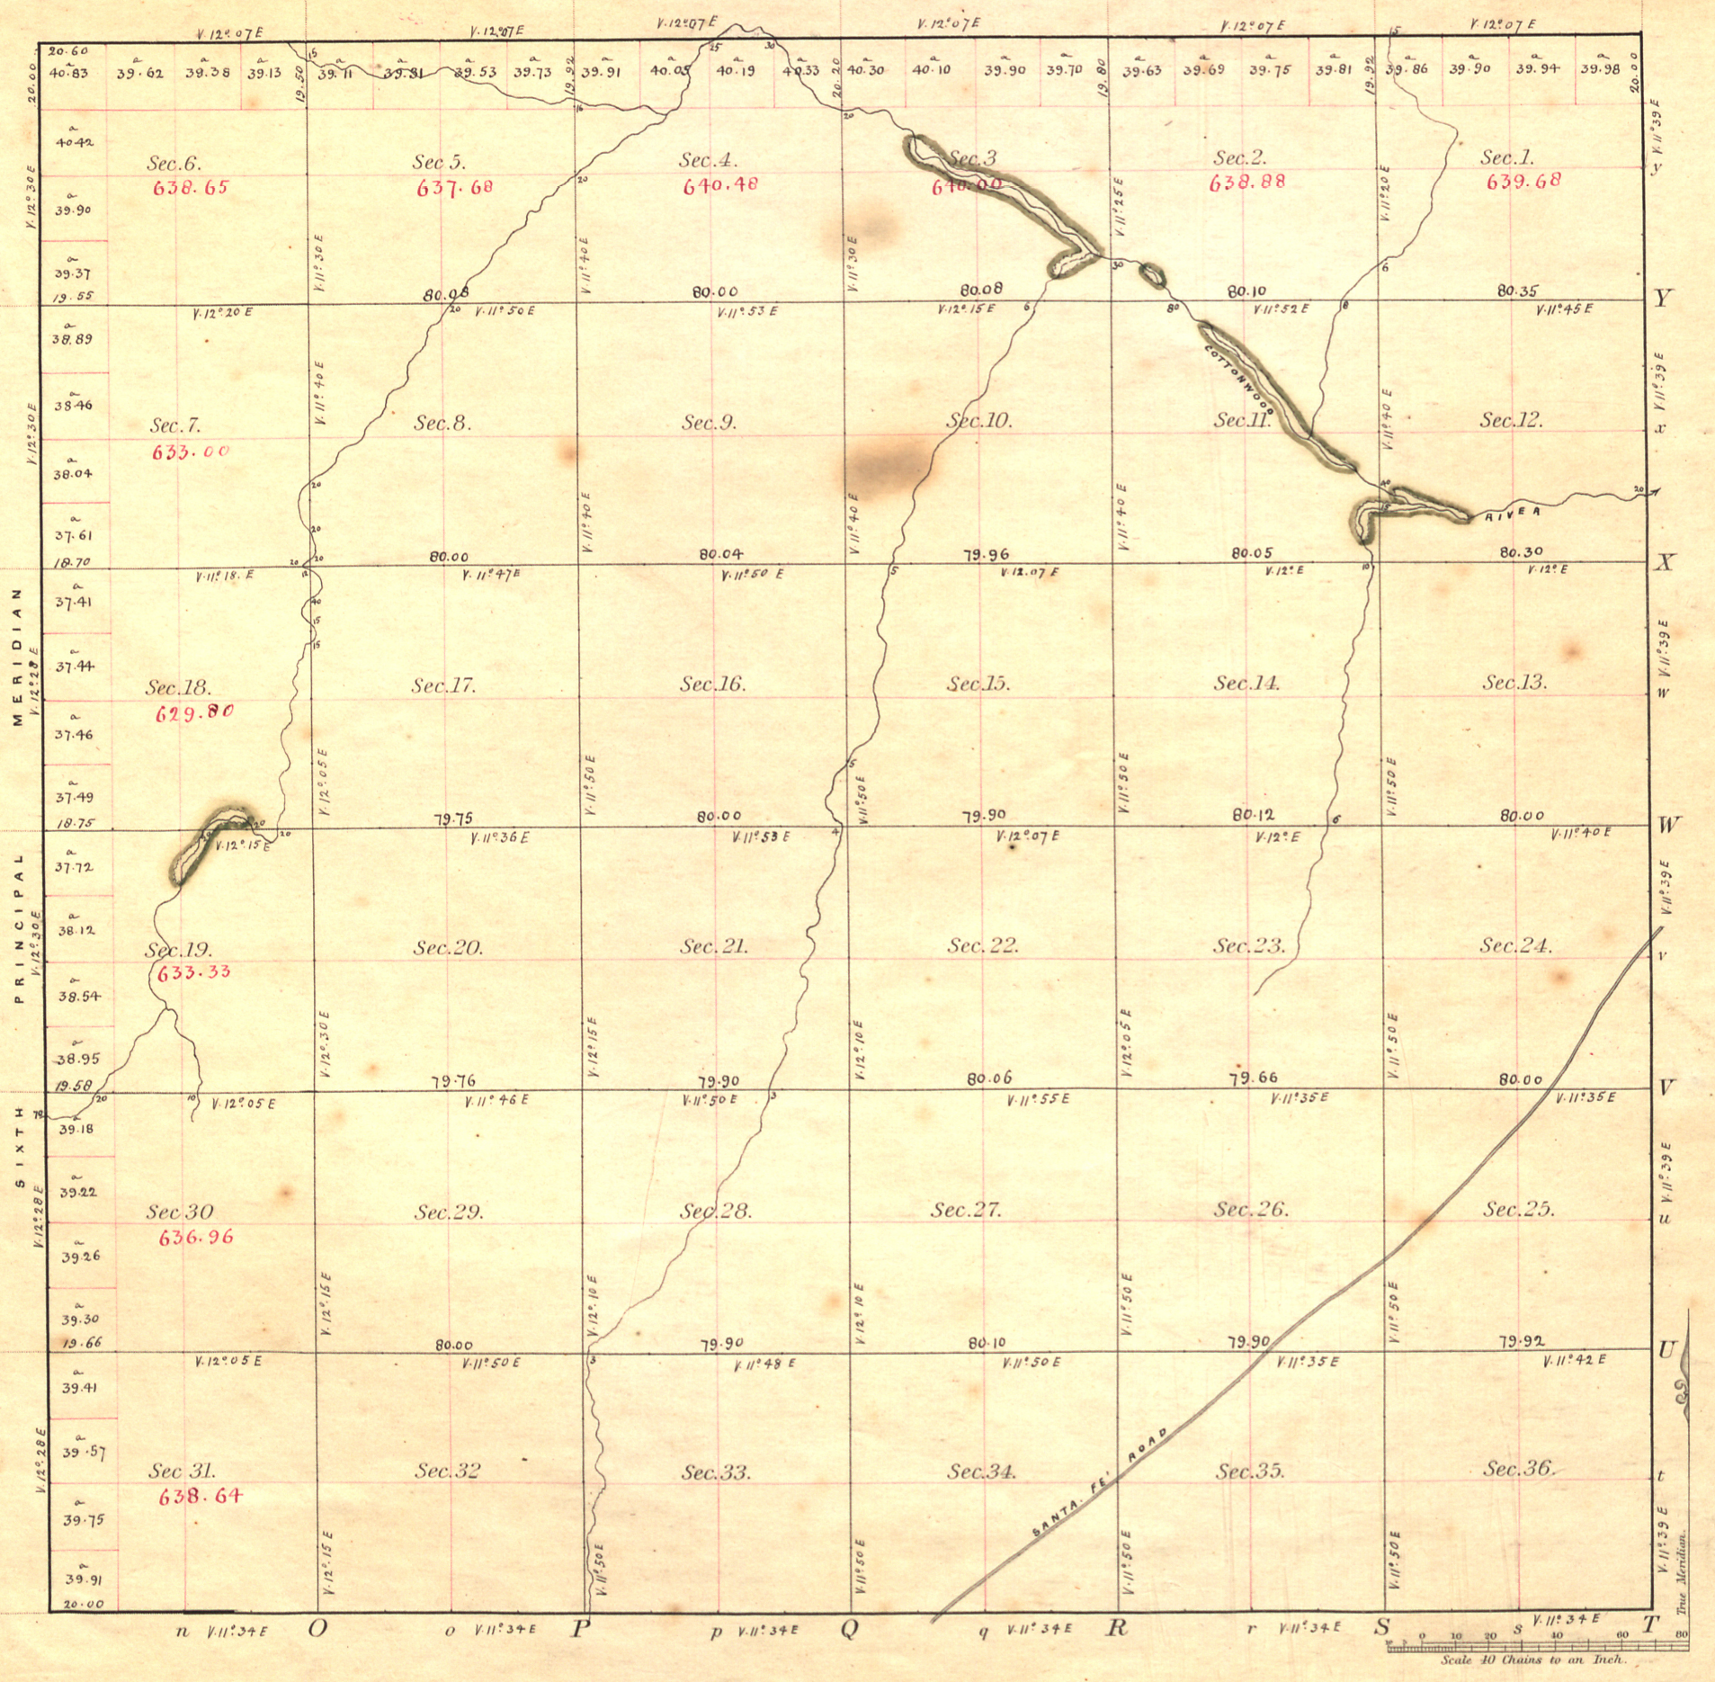
Original General Land Office Survey of 1857
All Lines have Monuments Set every Half Mile.
Original Monuments
Are Legally Unchangeable
By Law!
County Surveyors and
Their Corners marked

Slide 6
What so special about these stones and other markers?
19-1422. Rules to be observed in resurvey under authority of the United States.
In the resurvey of land surveyed under the authority of the United States, the land surveyor shall observe the following rules:
First, Section and quarter-section corners, and all other corners established by the government survey, must stand as the true corners.
Second, They must be re-established at the identical spot where the original corner was located by the government surveyor, when this can be determined.
Third, When this cannot be done, then said corners must be re-established in accordance with the provisions of K.S.A. 19-1412, and amendments thereto.
History: L. 1891, ch. 89, § 6; R.S. 1923, 19-1422; L. 1961, ch. 136, § 4; L. 2011, ch. 49, § 10; July 1.

Slide 7
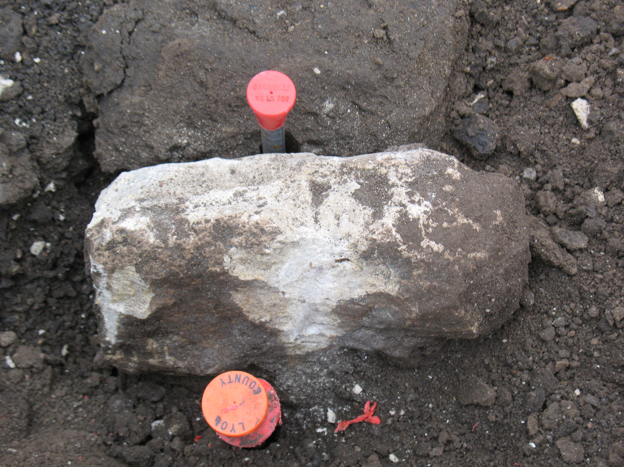
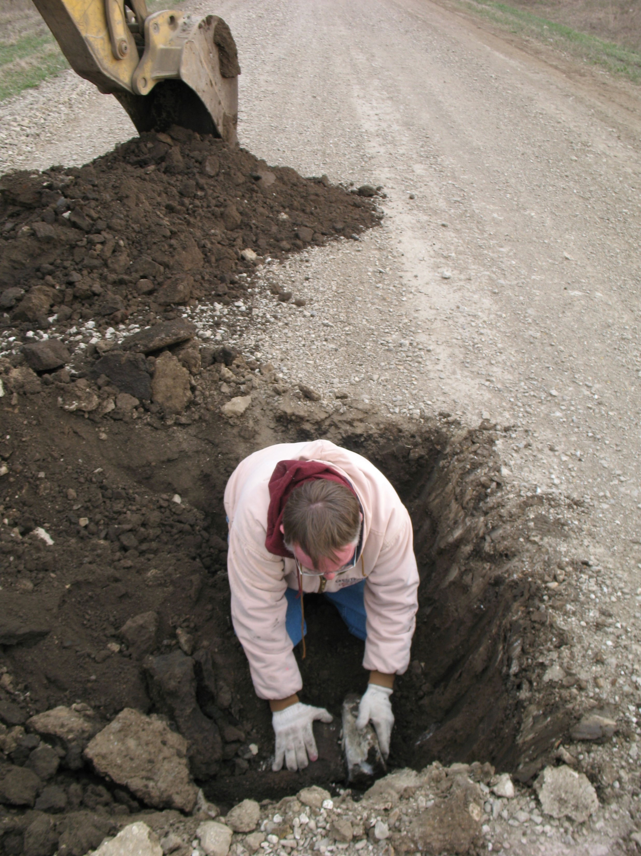
Backhoe strikes “White Gold”!
MY ID CAP
LYON COUNTY ID CAP

Slide 8
Who benefits from County assistance?
Number One is the Landowners / Taxpayers! In the Short run and the Long run.
Making the survey more certain by making the search for controlling Section Corners more thorough. Fewer disputes later.
No direct expense to the taxpayer
Preservation of History / Honoring the Past Paying it Forward
Future surveys and those that pay for them (taxpayers) will benefit from the recovery because there should be less time and expense the next time a corner is needed. K.S.A. 58-2011
What should the Counties be doing about excavation for stones & markers?
Develop guidelines and rules clearly stating the process and obligations of the surveyor.
Post them on the County Engineer / Road & Bridge website

Slide 9
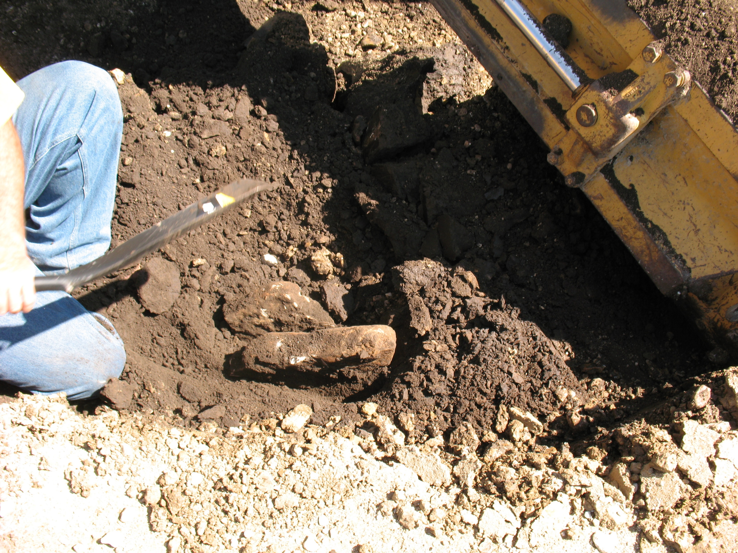
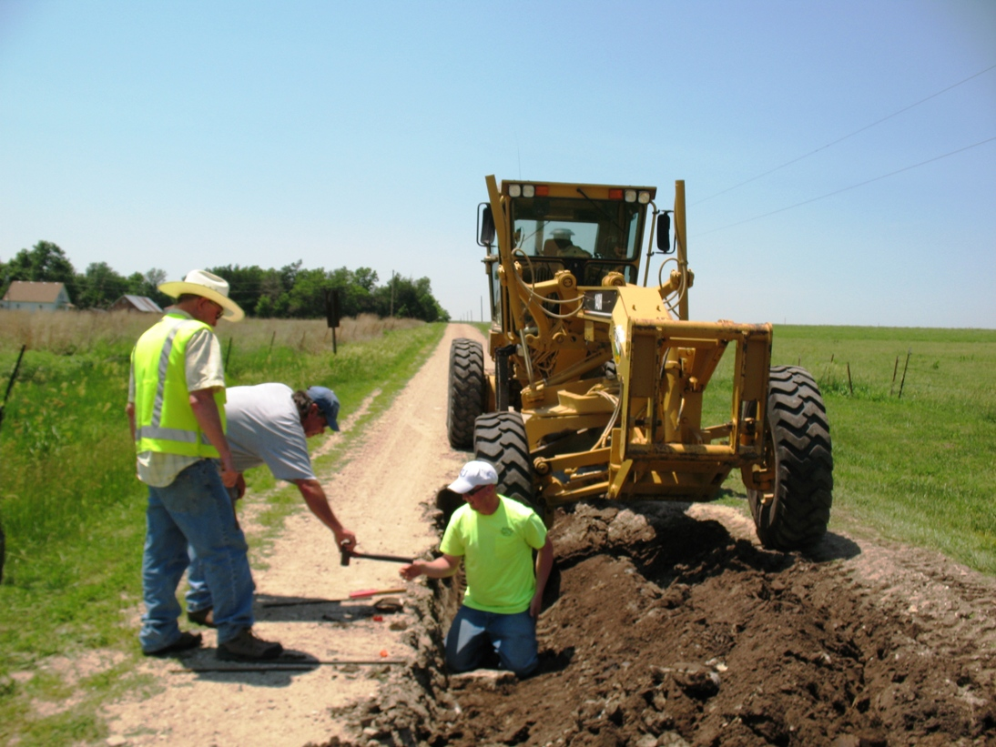
THE PROPER DIGGING TECHNIQUE WHEN USING A MAINTAINER
SETTING A REBAR UNDER
THE STONE: “MEMORIAL”

Slide 10
19-1430. Preservation of corner monuments; cost.
When a United States public land survey corner or section center corner monument located in a street or road:
(a) Is at risk of being displaced or destroyed;
(b) projects above the usual grade of a roadbed;
(c) is at risk of coverage by concrete, asphalt or other permanent type surfacing; or
(d) is at risk that fill will cover the corner monument more than two feet, the agency responsible for maintaining the road shall preserve the corner monument by employing a land surveyor to comply with the provisions of K.S.A. 58-2011, and amendments thereto. The cost of the preservation or reestablishment of the corner monument shall be paid by the agency responsible for maintaining the road, or if such corner monument is located on private property, by the landowner.
History: L. 1907, ch. 233, § 1; R.S. 1923, 19-1430; L. 1961, ch. 136, § 7; L. 2011, ch. 49, § 13; July 1.
Township versus County Unit Road maintenance?
“It’s not so much that you make mistakes, it’s what you do about them when discovered.”

Slide 11
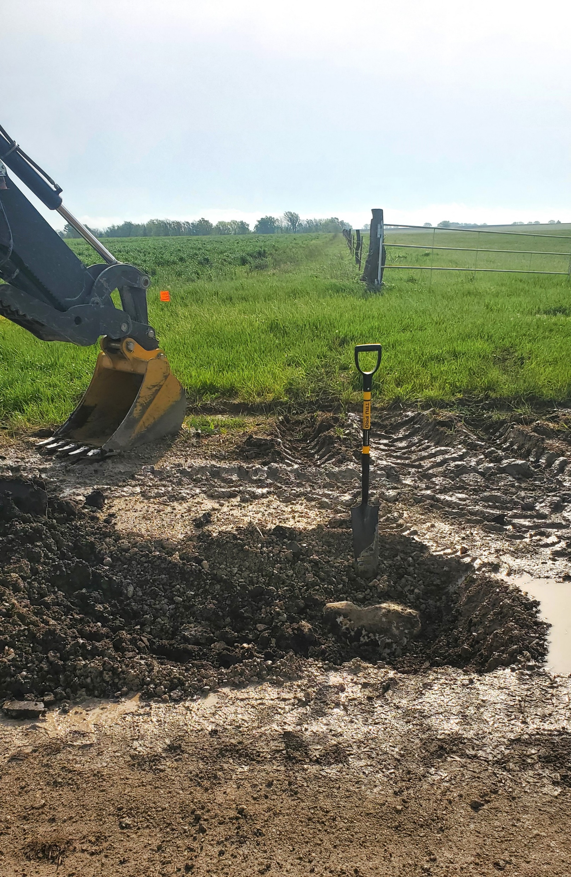
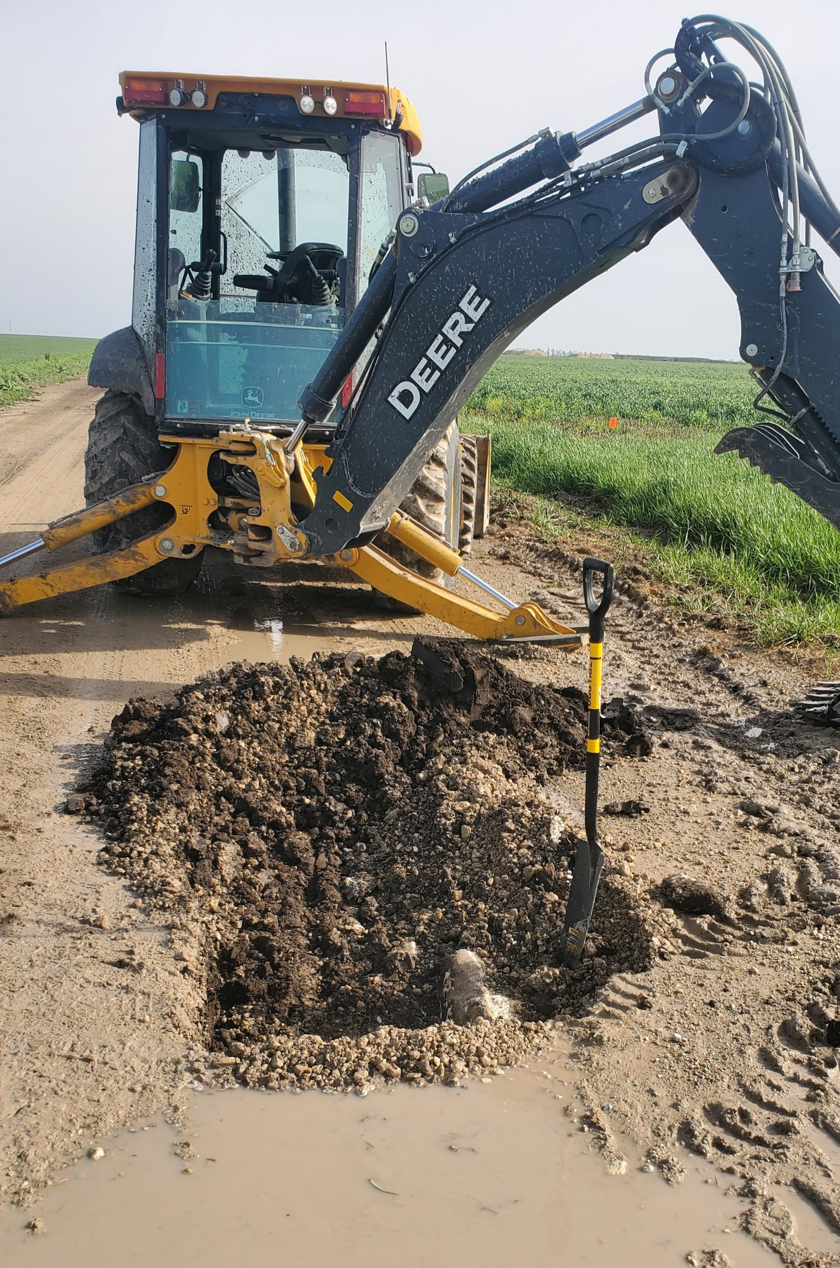
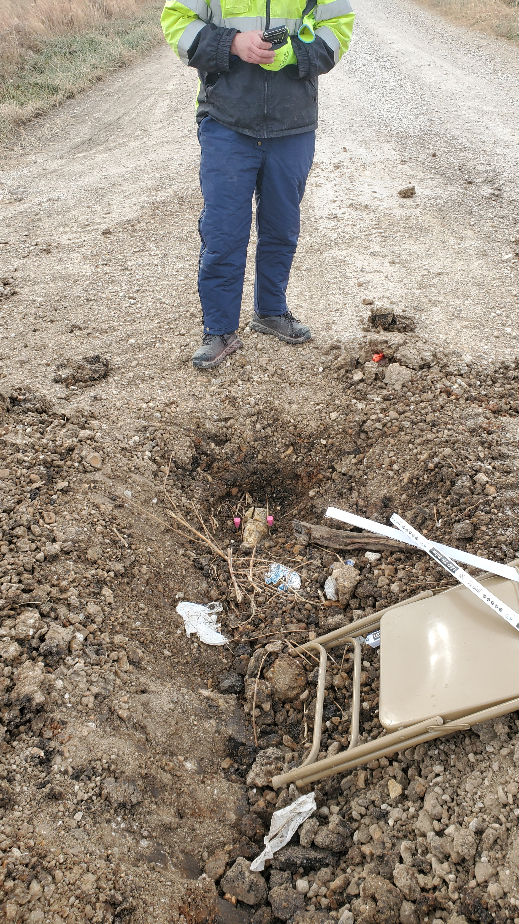
WHAT YOU DON’T WANT!
WHAT YOU DO WANT!
“AMATEUR NIGHT”!
“COUNTY CONTROL”!

Slide 12
YOUR PROCEDURES AND GUIDELINES SHOULD ADDRESS THE FOLLOWING:
WHO’S RESPONSIBLE FOR 811 ONE CALL? GET TICKET NUMBER!
HAS THE SURVEYOR DONE PRELIMINARY MEASUREMENTS AND KNOW WHERE TO LOOK SO THAT THERE ARE NO “WILD GOOSE CHASES”?
HAS THE SURVEYOR DONE RESEARCH AND KNOW WHAT THEY ARE LOOKING FOR? MAGNETIC VS. NON MAGNETIC
IS THIS IN ASPHALT VS. GRAVEL DIRT? EXPECTED DEPTH? TYPE OF EQUIPMENT NEEDED FOR THE RECOVERY.
IS THE SURVEYOR OR HIS REPRESENTATIVE GOING TO BE ON SITE TO DIRECT THE DIG?
HOW MUCH LEAD TIME IS REQUIRED BY THE COUNTY?
WHO IS THE SURVEYOR’S CLIENT?
REQUIRE THE SURVEYOR TO FILE HIS LAND SURVEY REFERENCE REPORTS ON ALL DUG FOR CORNERS, EVEN THE ONES NOT FOUND. NO NEED TO EVER DIG AGAIN!
ASPHALT VS. GRAVEL / DIRT

Slide 13
WHAT ABOUT ASPHALT ROADS?
A DELICATE SITUATION
Magnetic versus Non Magnetic Markers
REHAB PROJECTS ARE THE IDEAL TIME TO COMPLY WITH 19-1430
ASSESSMENT OF THE LIKELIHOOD THAT THE MARKER IS STILL THERE.
MAKE PROVISIONS FOR REPAIR BY COUNTY FORCES
THE USE OF MONUMENT BOXES: PROS AND CONS

Slide 14
THE ULTIMATE BENEFIT IS TO THE ULTIMATE END USER:
YOUR CITIZENS AND TAXPAYERS!
QUESTIONS? AND ANSWERS!
ssbrosemer@gmail.com

